Slide 1
Design and Development of Blockchain Based Land Registration System
Presented by
Anwar Hosain
Dept. of CSE
Roll No: 14502000929
Session: 2014-15
Institute of Science and Technology
Under National University
Presented by
Md Jahidul Islam
Dept. of CSE
Roll No: 14502000972
Session: 2014-15
Institute of Science and Technology
Under National University

Slide 2
Content List
Introduction
Motivation
Objective
Traditional Land Registration System
Blockchain
Application of Blockchain
Blockchain Based Secured Land Registration System
Diagram
Implementation
Features of Proposed System
Conclusion

Slide 3
Introduction
A blockchain based land registration is a recording system for any kind of a high value property real estate. These records can be used to protect owner’s right resolve disputes make sure ownership is correctly transferred to a new owner after sale prevent sale fraud.

Slide 4
Motivation
The land administration system in Bangladesh is not well-developed.
It is corrupt, inefficient, and unreliable and inherently contains systematic weaknesses.
Corruption has become a grave issue in this sector.
A World Bank survey reveals that most crimes and corruptions in Bangladesh take place in land-related services.
It has estimated that more than 3.2 million land-related cases are pending before the judiciary.
Land disputes often lead to violence and criminal offenses.
Too much hassle.

Slide 5
Objectives
Prevent fraudulent activities using Blockchain Technology.
Land registration information will be stored in distributed server with their hash ID.
It will protect the owner rights that no one can demand that land.
The transfer of the ownership is so time consuming. All transformation ownership will stored in a distributed server with their hash ID.
The whole processing is in online so the additional cost for laborer, equipment and manpower reduce.

Slide 6
Traditional Land Registration System
Buyer
Visit Land
Check Document
Make Decision
Registration and Payment
Ownership

Slide 7
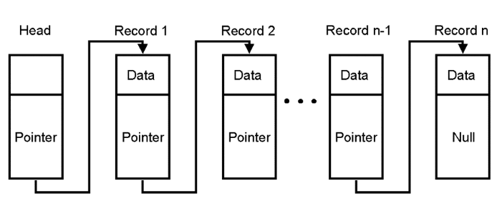
Blockchain
A system in which a record of transactions made in bitcoin or another cryptocurrency are maintained across several computers that are linked in a peer-to-peer network.
Diagram of Blockchain

Slide 8
Applications of Blockchain
Smart Contracts
Cloud Storage
Supply-Chain Communications & Proof-of-Provenance
Paying Employees
Electronic Voting

Slide 9
Proposed Land Registration System
Login
Google Map View
Add Documents Using Blockchain
Owned
Payment
Request

Slide 10
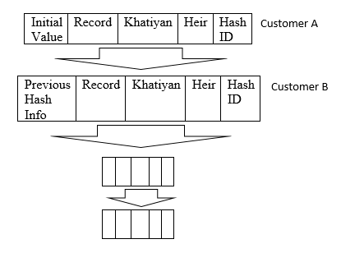
Creating Hash ID

Slide 11
Features of Proposed System
There are some features in our blockchain based land registration system.
Transparency
Integrity
Secured
Fast transaction
Identity management
Immutability

Slide 12
Implementation

Slide 13
The Comparison between Traditional System and Proposed System
Features | Traditional System | Blockchain Based System
Fraud Prevention | Does not ensure | Ensure and possible
Confidentiality | No | Yes
Data integrity | Does not ensure | Ensure
Trust worthiness | Cannot be trusted | Can be trusted
Hassle free | No | Yes
Time Effectiveness | No | Yes
Security | Less | More security
Process | Slower | Faster
Transaction | Slow | Fast

Slide 14
Conclusion
The current land registration system is unsecured and less authentic.
My proposed system assured the way of legal and valid transaction of land among the valid authorities.
And also ensure owners authentication, legal authorities, data integrity and protect unusual activities regarding land.
The proposed system will develop efficiently.

Slide 15
Future Work
This time the system working on web only. Our future goal is make a mobile app such as android and IOS app.
User can watch his/her land in Google maps.
User can buy/sell using bit coin.
This time the system act like a broker but in future this system may be one the best trustable land buying and selling system for people.

